Slide 1
AMTRAK FOIA CHALLENGE
Team 80:
Jason Benner

Slide 2
Challenge Overview
When speaking with the representative from Amtrak the challenge seemed to be as follows:
Right now, Amtrak has one employee who has vast institutional knowledge and when they are out sick or otherwise unavailable it proves difficult for others to categorize FOIA requests and determine who to ask for the information to complete the requests
They need a system that takes in the FOIA request and produces a list of departments (or categories) and relevant people to contact about gathering required information

Slide 3
Programs Utilized to Create MVP
React Library (UI – Frontend)
Standard library, used extensively so it is easy for others to understand and maintain
Quick to prototype
Ollama (AI model – Backend)
Fairly standard usage. Documentation easily available and has a well-maintained list of open source models.
Runs AI models locally to avoid issues with data privacy

Slide 4
AI Use in Project
This project utilizes AI. It is running Ollama to serve the Phi4 model that is an open source model from Microsoft
Model is 14B parameter model
Model designed for reasoning/logic and relatively fast inference
Ollama has many open source models to choose from but this one seemed to provide best results to size for this project
When Googling for questions around programming I would sometimes use the “AI Overview” section of the search, this displays code snippets that you can use and change to your specific needs

Slide 5
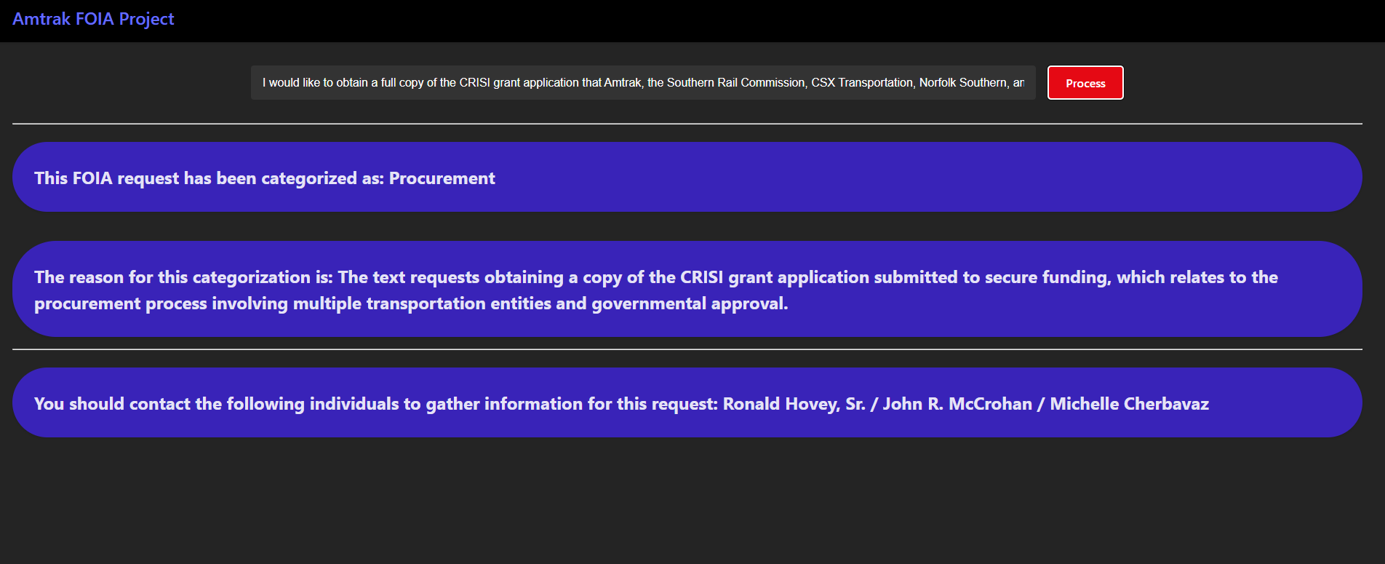
Current Project Main Page
Search Input to put FOIA Request Text and Button to send to AI model to categorize
Card to display AI categorization result
Card to display AI explanation
Card to display relevant contacts at Amtrak

Slide 6
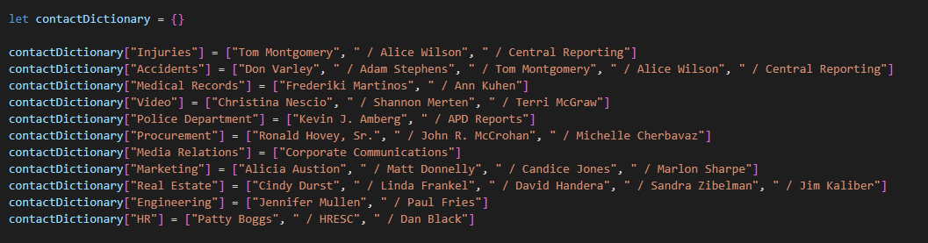
Current Project Categorization Process
Dictionary of categories to relevant individuals (Ideas on how to improve this in later slide)

Slide 7
Current Project Categorization Process
When the FOIA request text is submitted we also create list of the same categories
Utilize this list of categories along with FOIA search text in prompt to model and have model return JSON

Slide 8

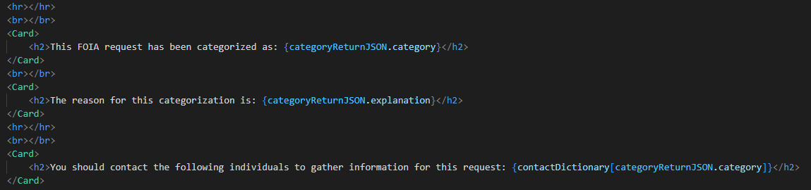
Current Project Categorization Process
Use React state to store the return in short term memory and update the cards, use the category to person dictionary to determine the relevant individuals

Slide 9
Ideas on Improvements
Use database to store people and the relevant departments (categories) they are involved with
Create another page on the site for updating/changing this department/people database
Use the unique values from departments (categories) database to build the categories variable in the prompt
Potential methods to enhance the AI model categorization results
Few shot prompting to give the model a better idea of what categories we want FOIA requests categorized as
Fine tune the model using a program, have seen the tool Unsloth mentioned for doing this with Ollama

